Slide 1

Reducing Churn:
INCREASING TENURE OF TELCO'S MONTH-TO-MONTH CUSTOMERS
Barbara Marques | Feb. 8, 2021
Notes:
Good morning. My name is Barbara Marques and I will be presentingmy proposed to solution to _____________________

Slide 2
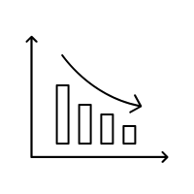



OUR AGENDA
EXECUTIVE
SUMMARY
EXPLORING
THE ISSUE
RECOMMENDED SOLUTION
ANTICIPATED OUTCOME
A quick look at our goal, analysis and significant findings.
Reviewing the data and pinpointing a driver of churn.
Our informed recommendation to reduce churn.
Expected results and a look at our next steps.
*An appendix with detailed information on my analysis is included as the last slide.
Notes:
We will start with a quick look at our goal, analysis and significant findings.
Next, we'll review the data and pinpoint a driver of churn.
I will present my informed recommendation to reduce churn.
Finally, we'll look at expected results and talk about the next steps to take.

Slide 3
Executive Summary
GOAL
DATA SET
Identify the driver of customer churn for Telco's month-to-month customers and recommend a targeted solution.
Telco’s database of 7,043 customers which includes contract details, services, monthly rates and tenure.
SIGNIFICANT FINDINGS
- 88% of month-to-month customers (MTM) who churn have no tech support.
- Month-to-month customers with no tech support have an average monthly tenure of 14.
- Month-to-month customers withtech support have an average monthly tenure of 24.
RECOMMENDATION
Provide and promote free tech support for month-to-month customers.
Notes:
My goal was to ....
I used ....
My analysis revealed that 88% of MTM customers who leave us do not have access to Telco's customer tech support team.
On average, these customers leave us within 14 months.
As compared to those with tech support who have an average tenure of 24 months.

Slide 4
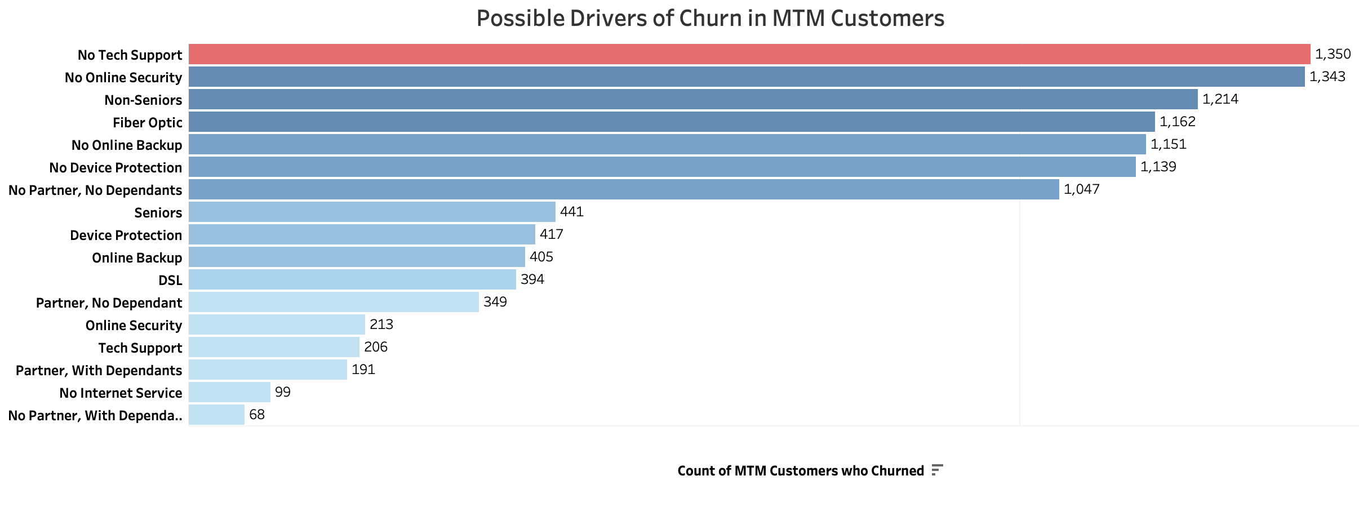
The issue:
3,875
MTM SUBSCRIBERS
43%
CHURN RATE
Total MTM Customers = 3,875
Total MTM Customer Churn = 1,655
14.1 mos.
AVERAGE TENURE
Notes:
Our data contained 3,875 MTM customers, with a total churn of 1,655 of those customers. MTM Customers currently have an average tenure of 14.1 months.
I began my analysis by looking at possible drivers of churn in MTM customers
A comparison of these factors revealed several key issues. The greatest influencer among these is customers who do not purchase tech support as part of their subscription.

Slide 5
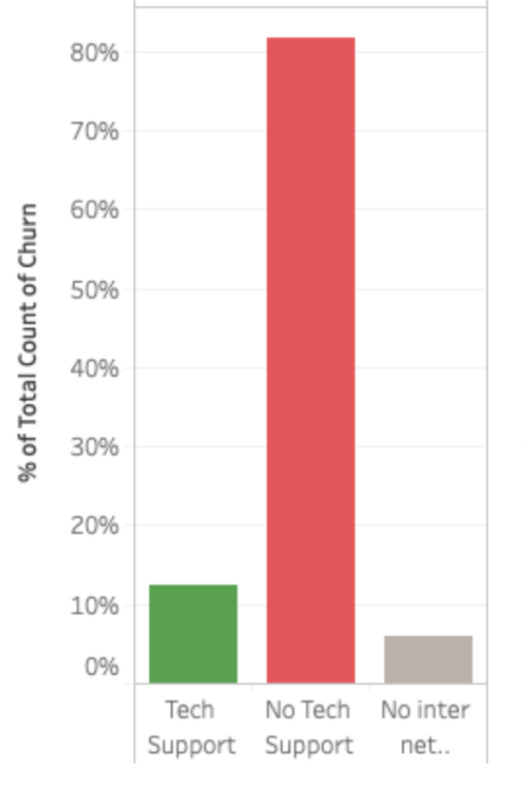
Understanding the problem:
82% of the month-to-month customers who churned did not have access to Telco tech support.
Month-to-month customers with access to tech support had a churn rate of only 11%.
Notes:
More specifically, of the 1,655 month-to-month customers who left us, 1,350 did not have access to Telco's skilled tech support in the event that they experience difficulties with internet connectivity. 82%
In comparison Month-to-month customers with access to tech support had a churn rate of only 11%.

Slide 6

Recommendation
Provide complimentary tech support to month-to-month customers for their first 12 months of service.
Notes:
My recommendation is that Telco provide Provide complimentary tech support to month-to-month customers for their first 12 months of service.

Slide 7
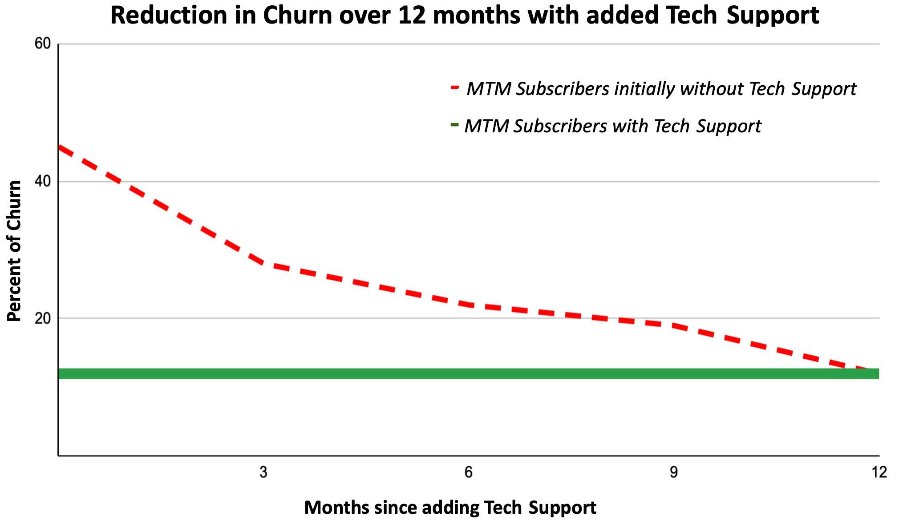
Anticipated Outcomes:
Month-to-Month customer churn reduced to 12% within 1 year
_______
Average tenure of MTM customers increased from
14 to 24 months.
Notes:
With access to free tech support, we can expect to see a jump in monthly tenure of MTM customers with internet service, which is 96% of all of our MTM'ers
We can expect the average tenure of MTM customers to increase 24 months. Which is equivalent to the average monthly tenure of all mom customers who currently have access to Telco's excellent customer tech support team.

Slide 8



Conclusions
KEY DRIVER
RECOMMENDATION
NEXT STEPS
The key driver of churn among month-to-month customers at Telco is a lack of technical support for internet customers.
Providing complementary tech support to internet customers will reduce churn and raise average monthly tenure to 24 months.
Further analysis of other leading drivers of churn
may lead to further reductions in attrition of month-to-month customers.
*For detailed information on the data analyzed, please refer to the appendix.
Notes:
In conclusion, I have identified a lack of access to technical support as the key driver of churn for Telco's MTM customers.
We anticipate that providing free customer tech support In the form of telephone, chat and/or online videos, would increase the average monthly tenure of MTM customers to 24 months, thus reducing churn.
Given more time and resources to explore the issue, I would look at additional services that might be bundled and offered to mom customers to further reduce churn among this customer group.
Thank you for your time and attention. You will find details of my analysis in the two appendices attached to this presentation.

Slide 9
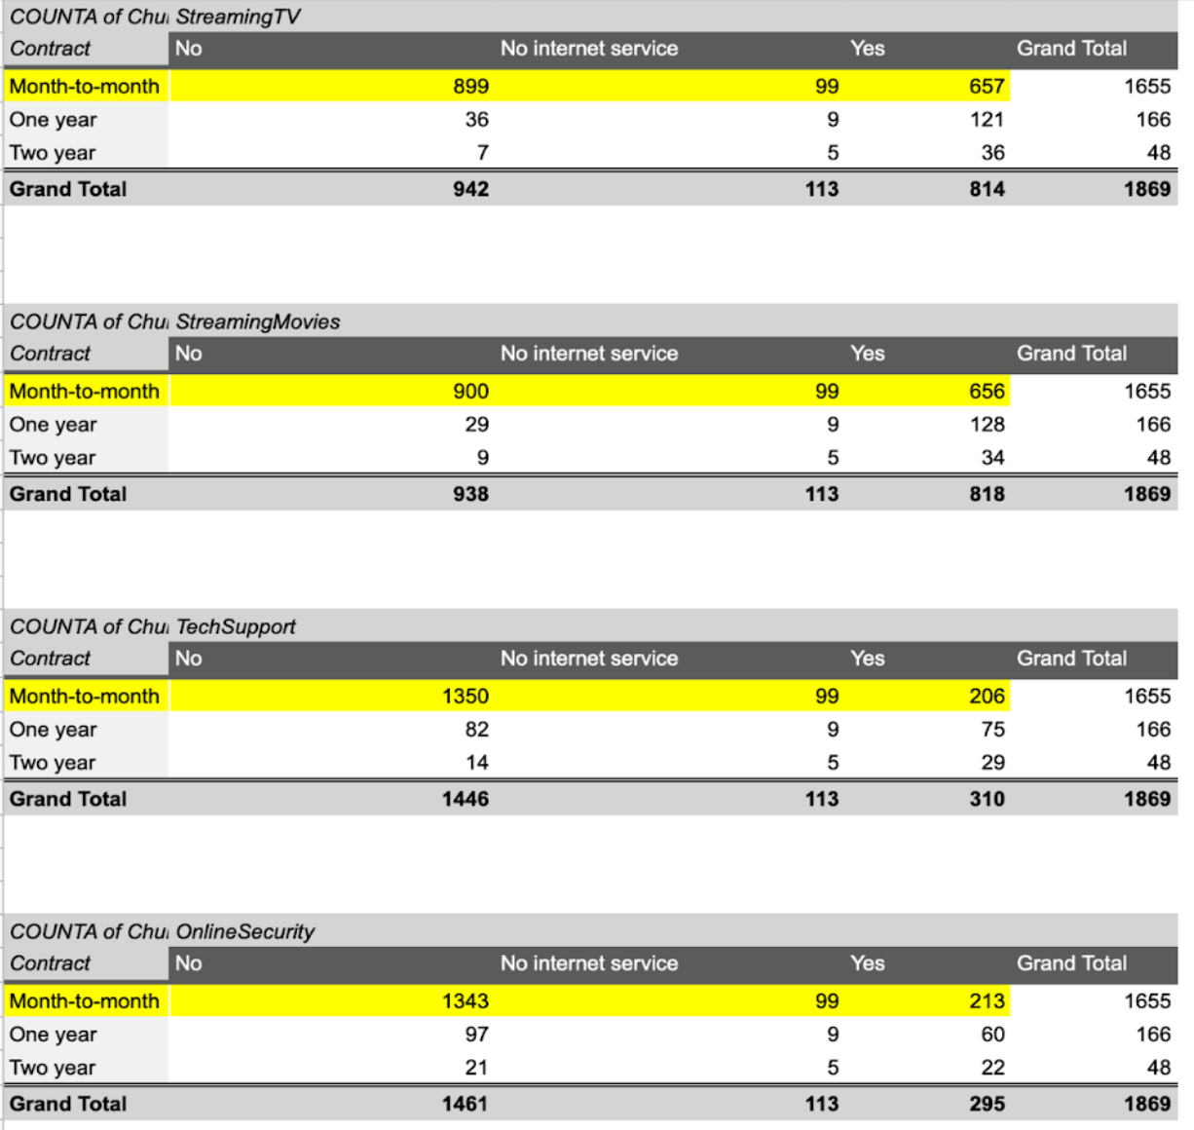
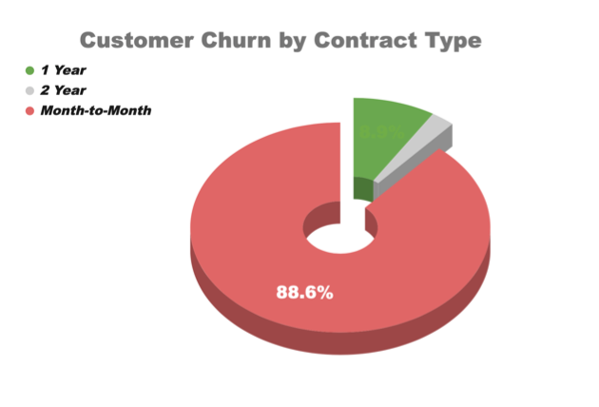
Appendix 1

Slide 10
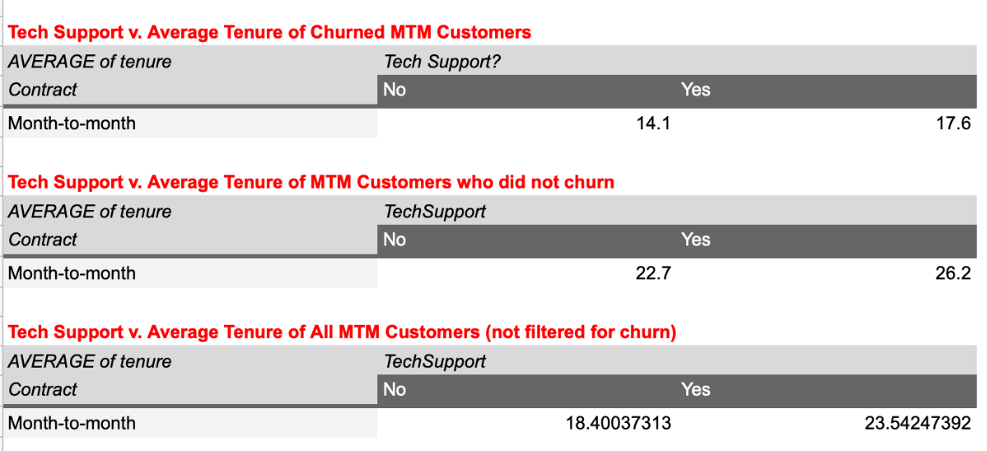
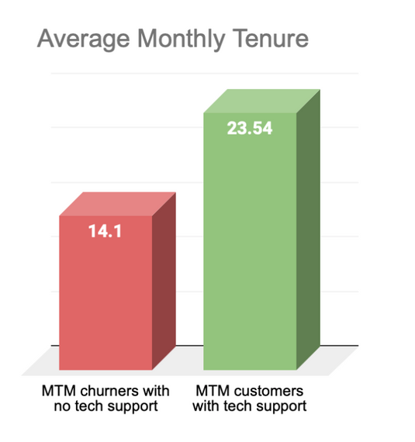
Appendix 2

